Slide 1

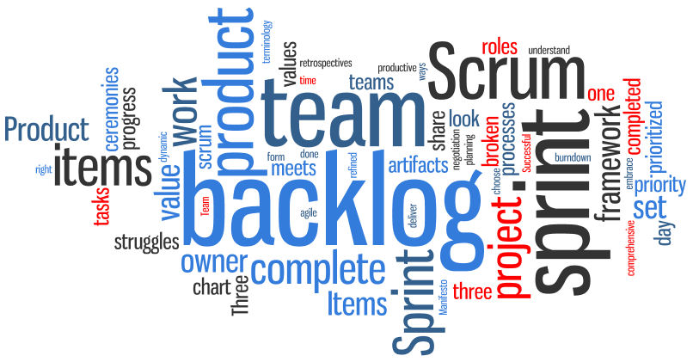

Sprint TWO
Lu Min,
Weicheng Yu,
Yansen Liu
Xiang Chen,
Dawei Li
Notes:
‹#›
Hello everyone, this is the Initial plan report by Team 3. We pick up the outline and important information to show you because of limited time. As you see, the name of our product is ProPal. Here is the Logo, it is designed by Yansen our … leader.

Slide 2
Overview
Software Architecture
Design pattern
Database
Configuration
Testing
New features and demo

Slide 3
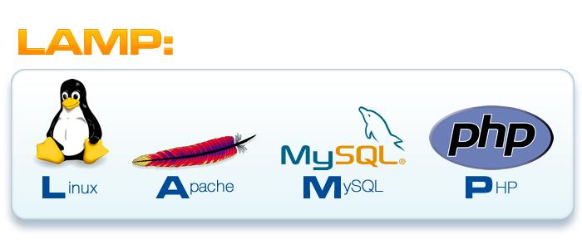
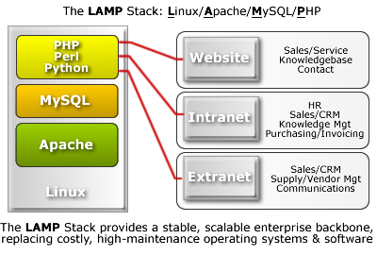

Software Architecture
*
Notes:
‹#›

Slide 4
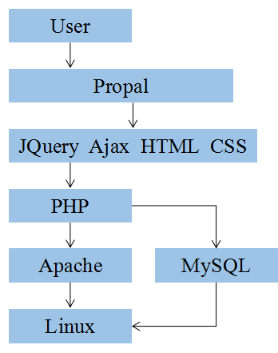
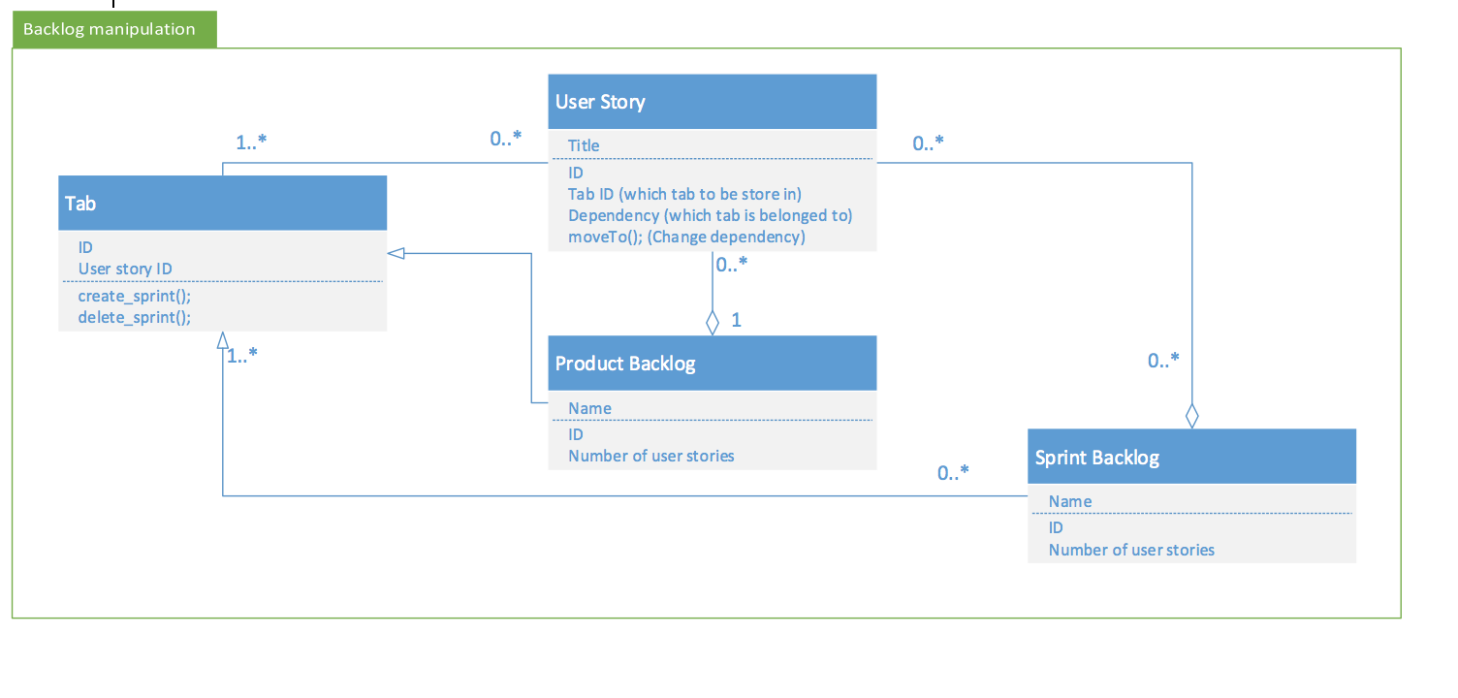
Software Architecture
*
Notes:
‹#›

Slide 5
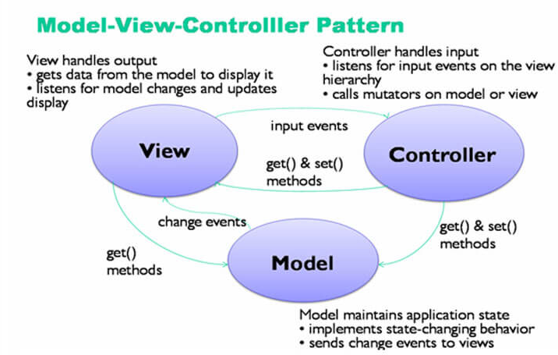
Design Pattern
Model:
MySQL
View:
HTML, CSS，JQuery, Javascript
Controller:
PHP

Slide 6
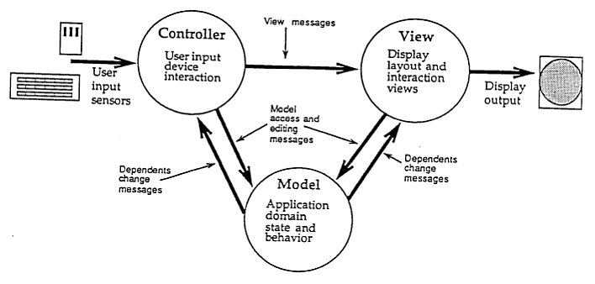
Design Pattern
*
Model | View | Controller
Database | UI, Web Interface | Business Logic
MySQL | HTML,CSS,Javascript,JQuery | PHP
Store all the data | Present the front-end web page | Exchange data between Model and View
Notes:
‹#›

Slide 7
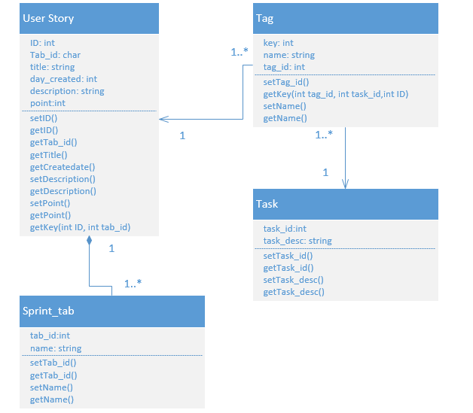
Controller
*
Class Diagram
Based on PHP
Insert
Retrieve
Notes:
‹#›

Slide 8
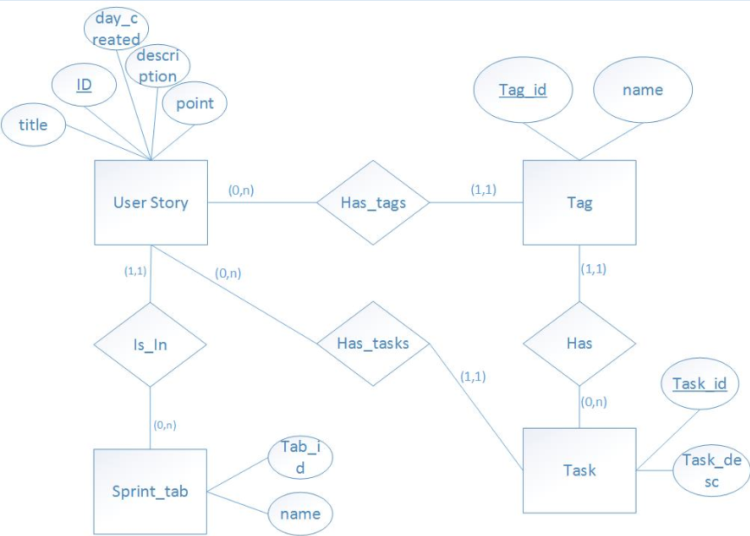
Model:
Database
MySQL(WHY?)
Easy to use
Free
Scalable
OS
Database modeling

Slide 9
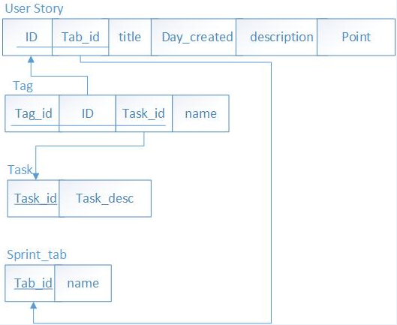
Database (Con.)
Database modeling
Schema
Primary Key
Foreign Key
Constraints

Slide 10
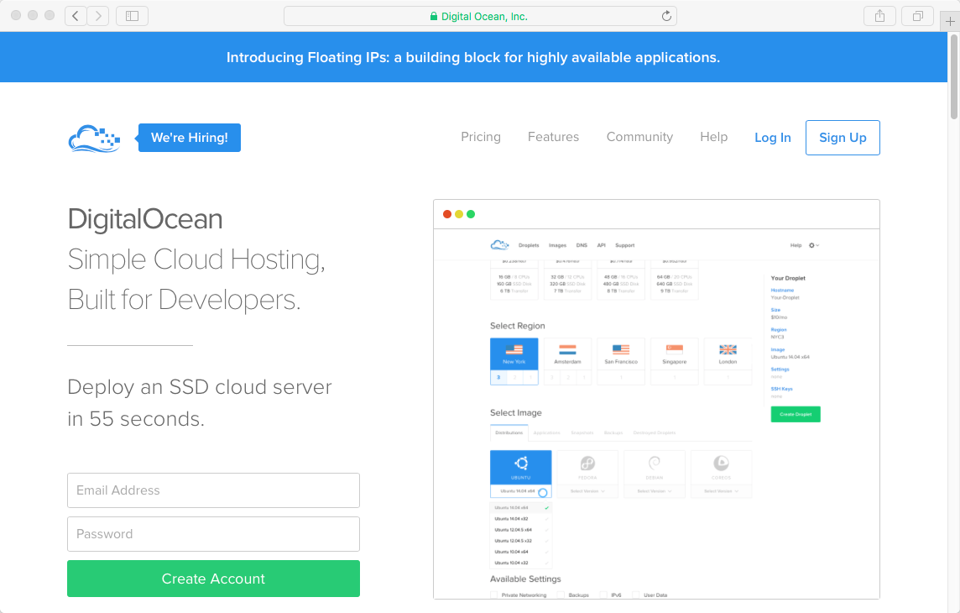
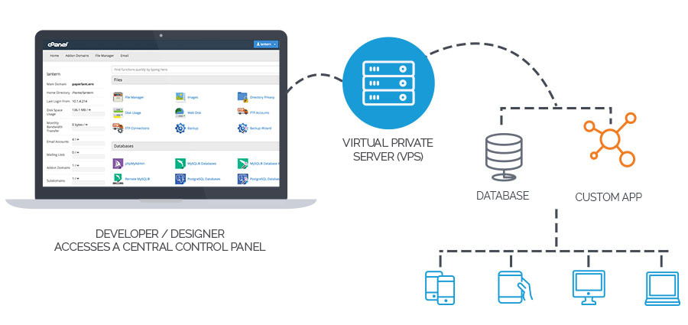
Deployment
*
SSH connection
Install Apache Server
Install PHP (Version)
Install MySql Server (Create Database)
Notes:
‹#›

Slide 11



Configuration
*
Test On Local
Avoid Code Conflicts
Easy to Revert
Manage Commit Record
Notes:
‹#›

Slide 12
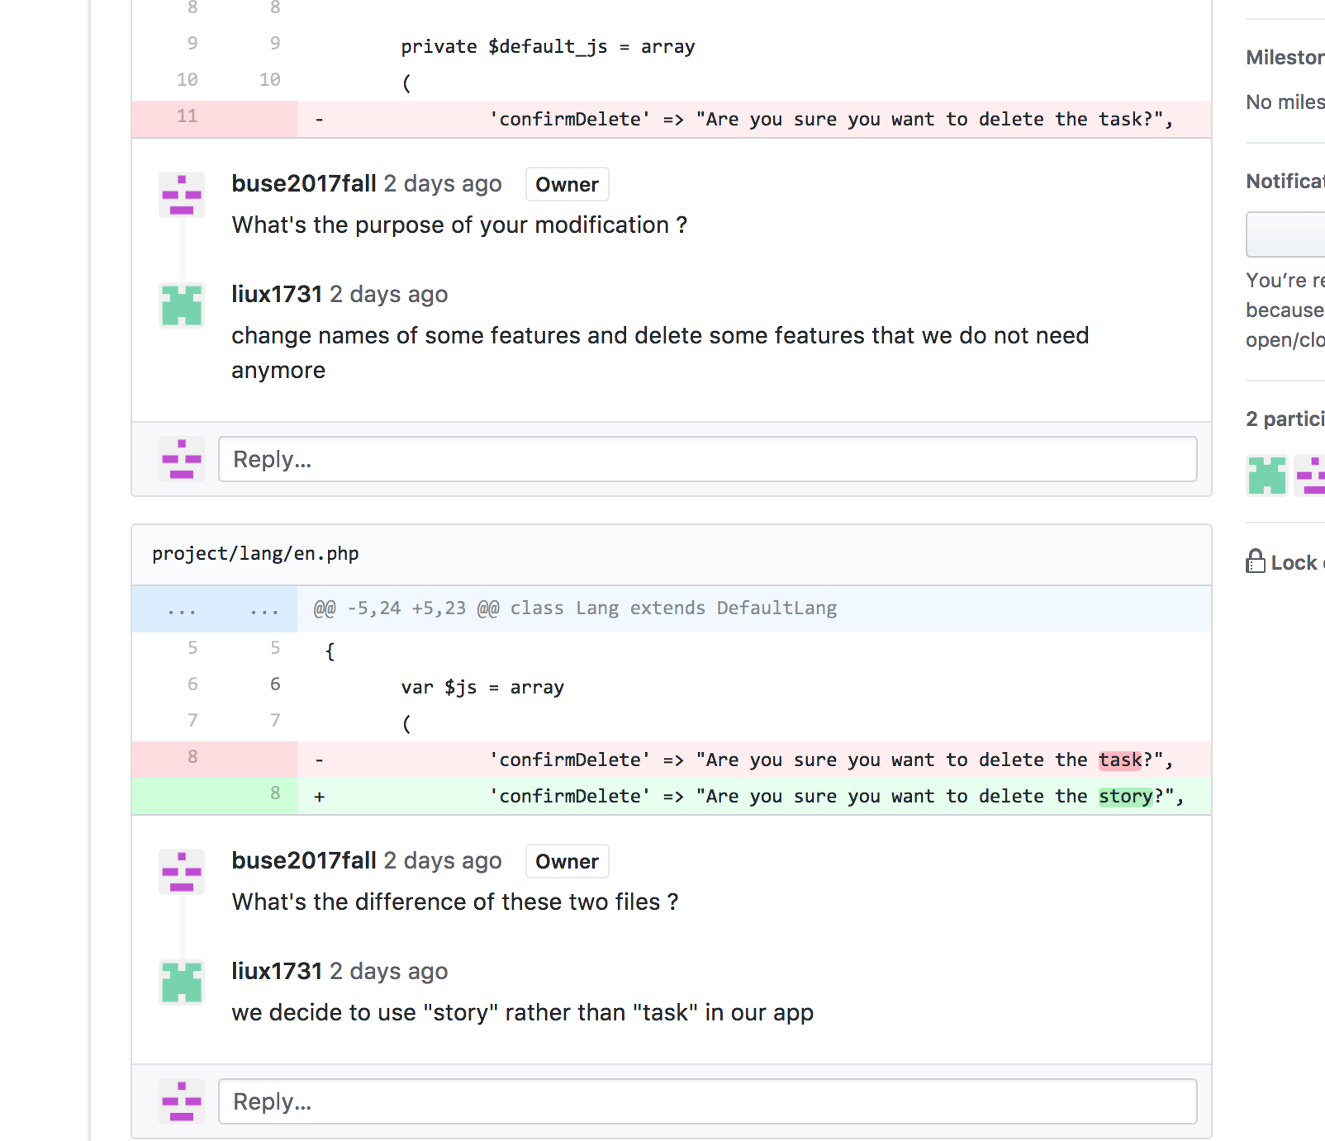
Code Review
*
Finding bugs early
Coding standards compliance.
Teaching and sharing knowledge.
Consistent design and implementation.
Higher software security.
Confidence of stakeholders
Notes:
‹#›

Slide 13
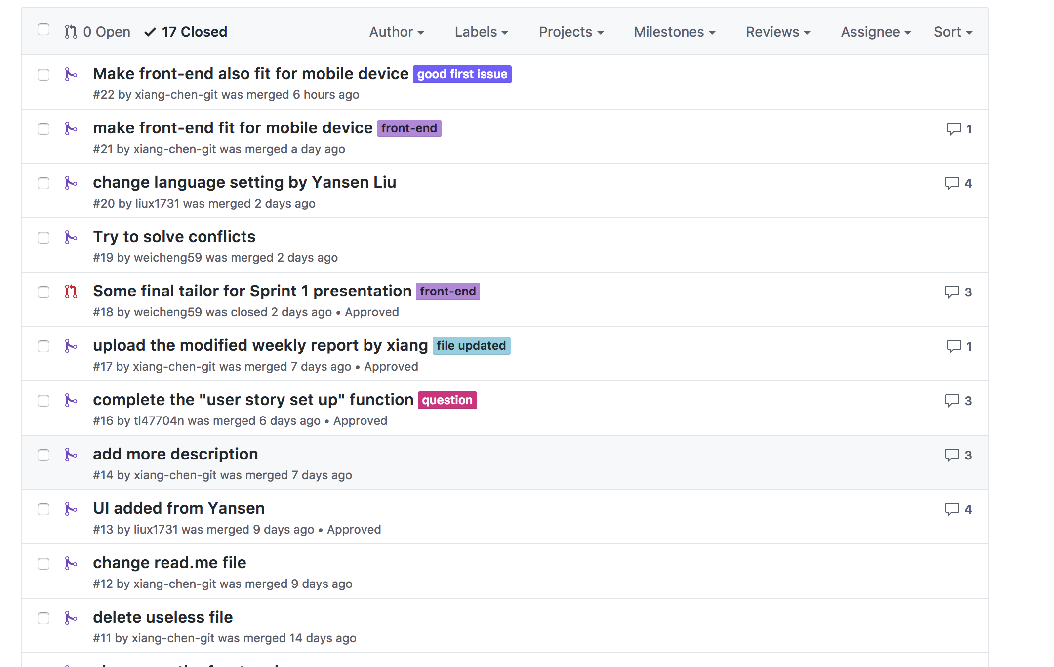
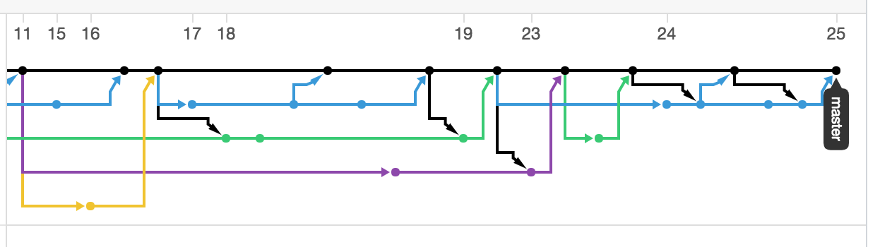
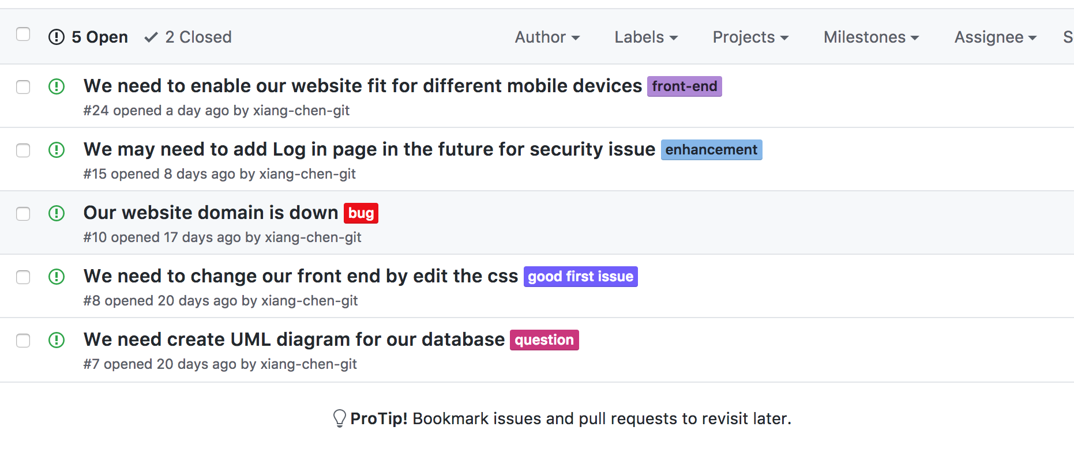
Integration
*
Leverage Github for integration
Maintain Code Change History
Manage Pull Request
Figure Out Issues
Notes:
‹#›

Slide 14
Unit Test
Manual testing only at Sprint 1
Javascript Unit Testing implemented in Sprint 2
Why Javascript first?
Majority of code(core function) is in Javascript
Relatively lower overhead
Will bring PHP unit test in Sprint 3

Slide 15

Unit Test - Jasmine
JavaScript testing framework
Good thing about Jasmine
Fast & Low overhead
No external dependencies
Run browser tests and Node.js test in the same framework

Slide 16
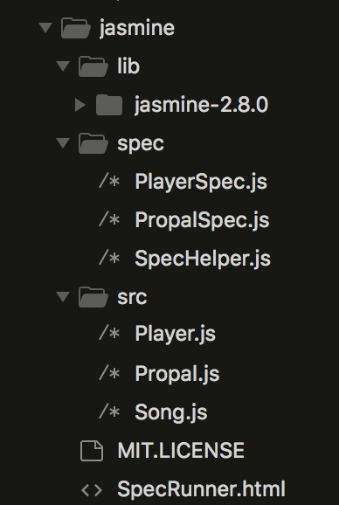
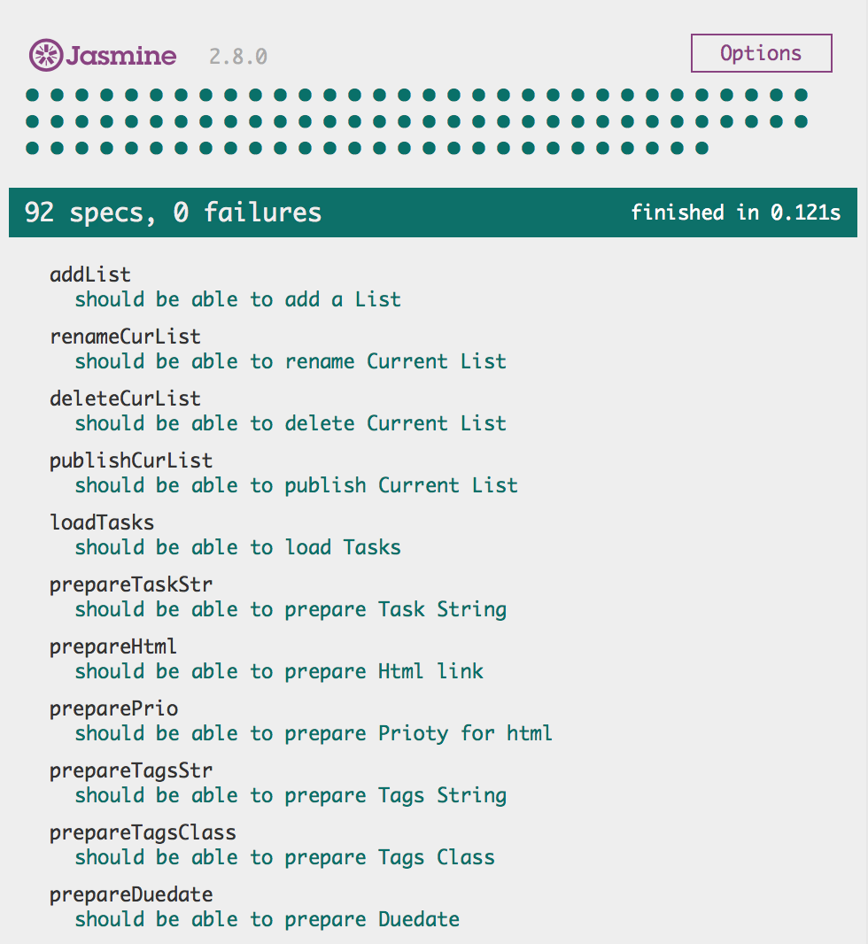
Unit Test - Details

Slide 17
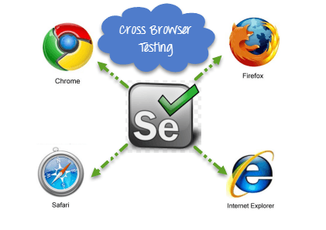
Integration Test
Tool : Selenium
Selenium is a software-testing framework for web applications.
Selenium provides a playback tool for authoring tests without the need to learn a test scripting language
Selenium also provides a test domain-specific language to write tests in a number of popular programming languages, including Java, PHP, Python, Ruby and Scala.
Selenium deploys on Windows, Linux, and OS X platforms.

Slide 18


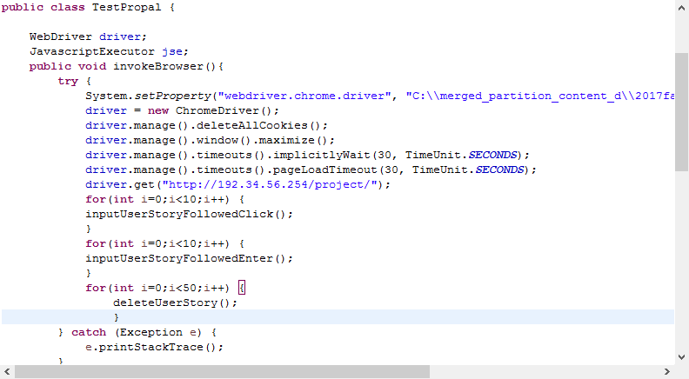
Integration Test
We integrated Selenium with Eclipse IDE;
Similar to Junit Test;
Write test case for integration test

Slide 19
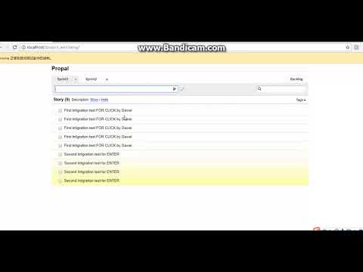
Integration Test
We write several test cases for testing:
Connection
Request Output
UI Interface Change
Rendered New Page

Slide 20
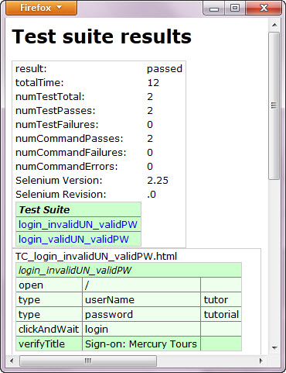
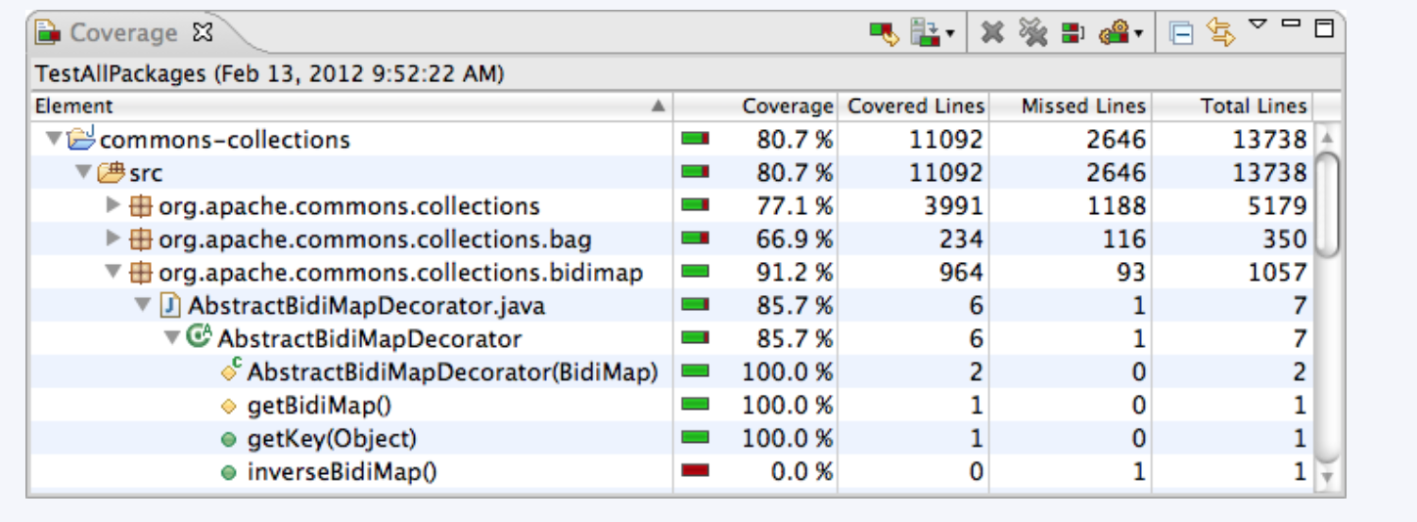
Integration Test
We will combine those results from integration test
with the results from other tests
into the “Test Metrics”

Slide 21
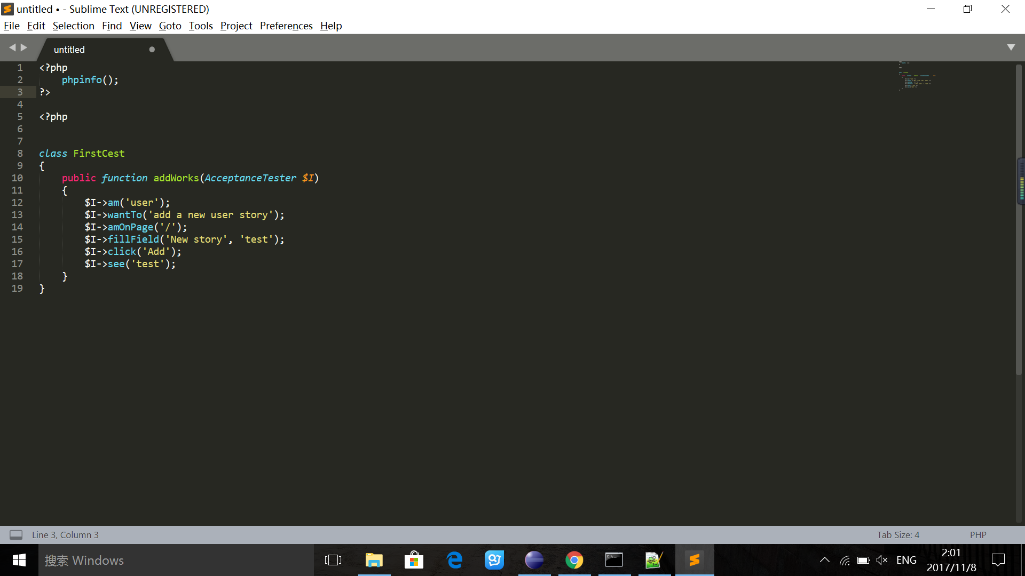
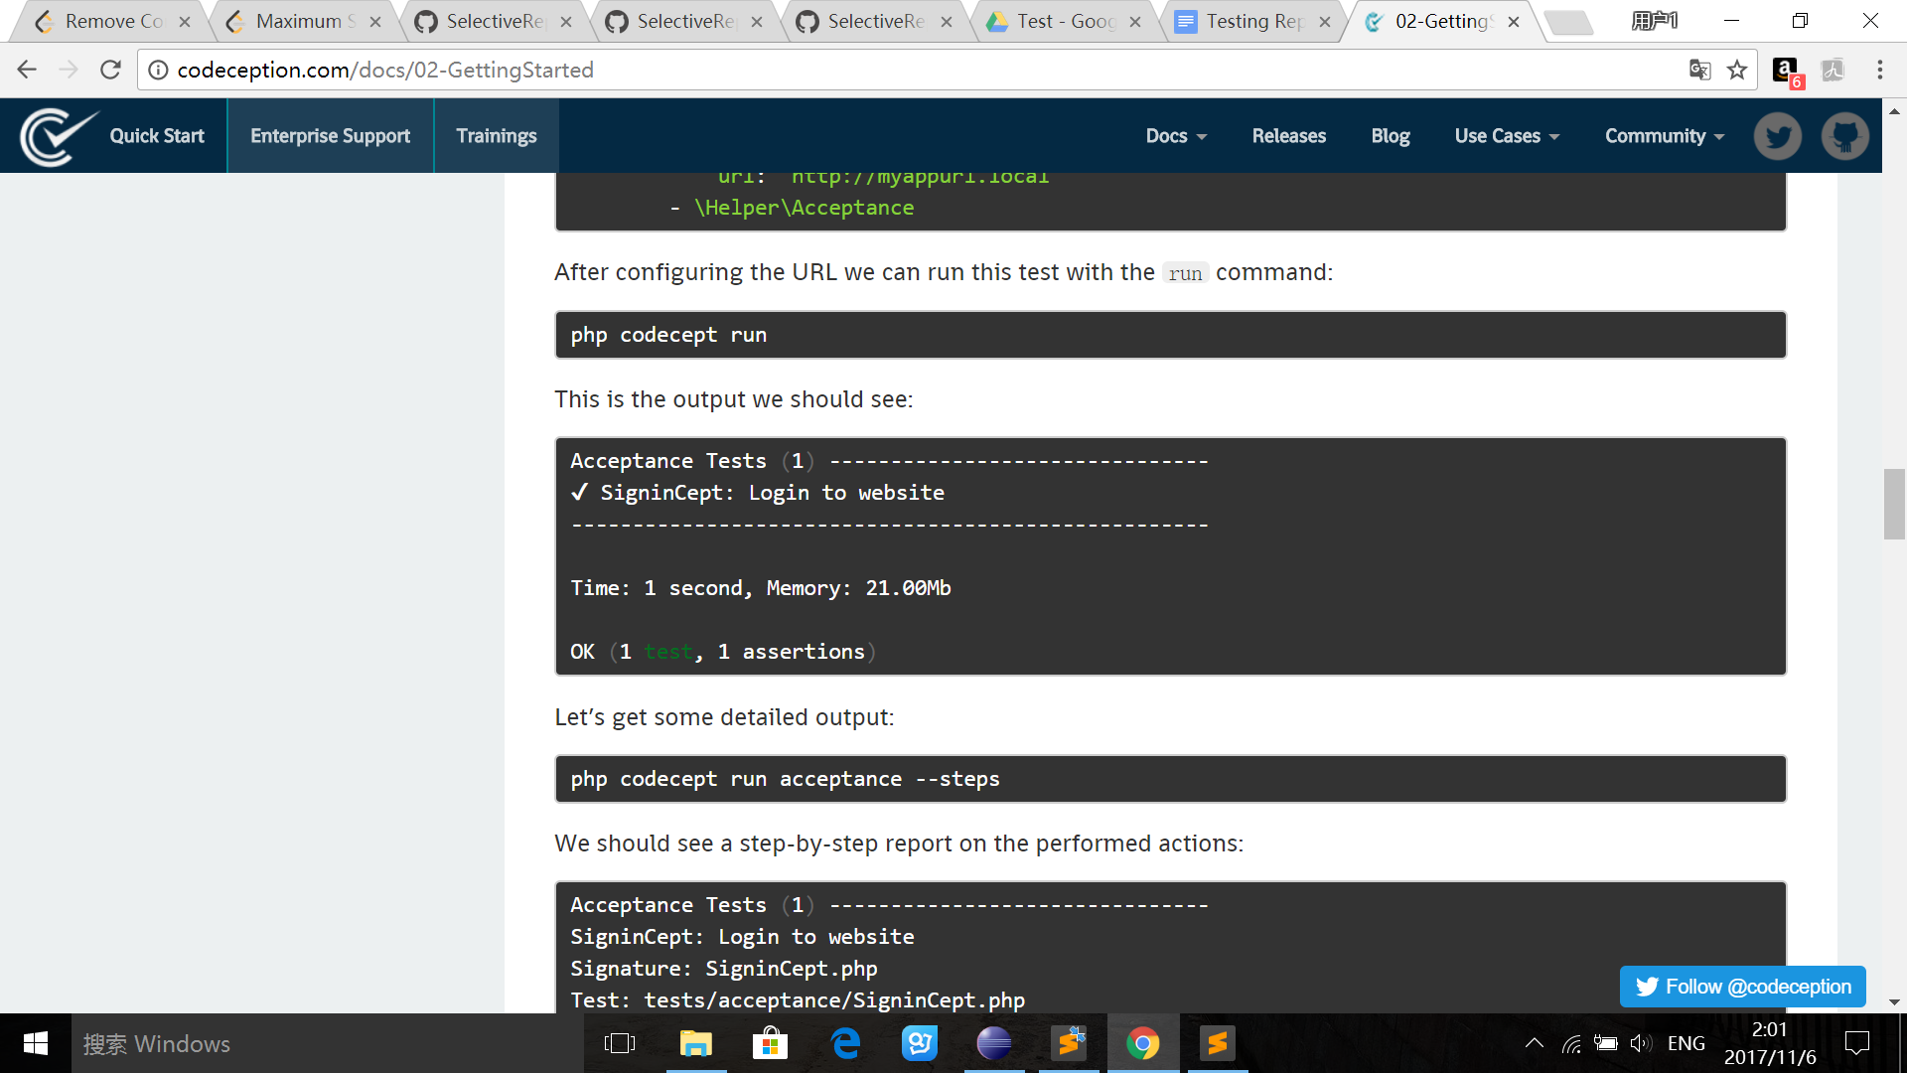
Acceptance Test
Acceptance testing:
Formal testing with respect to user needs, requirements, and business processes conducted to determine whether or not a system satisfies the acceptance criteria and to enable the user, customers or other authorized entity to determine whether or not to accept the system.

Slide 22
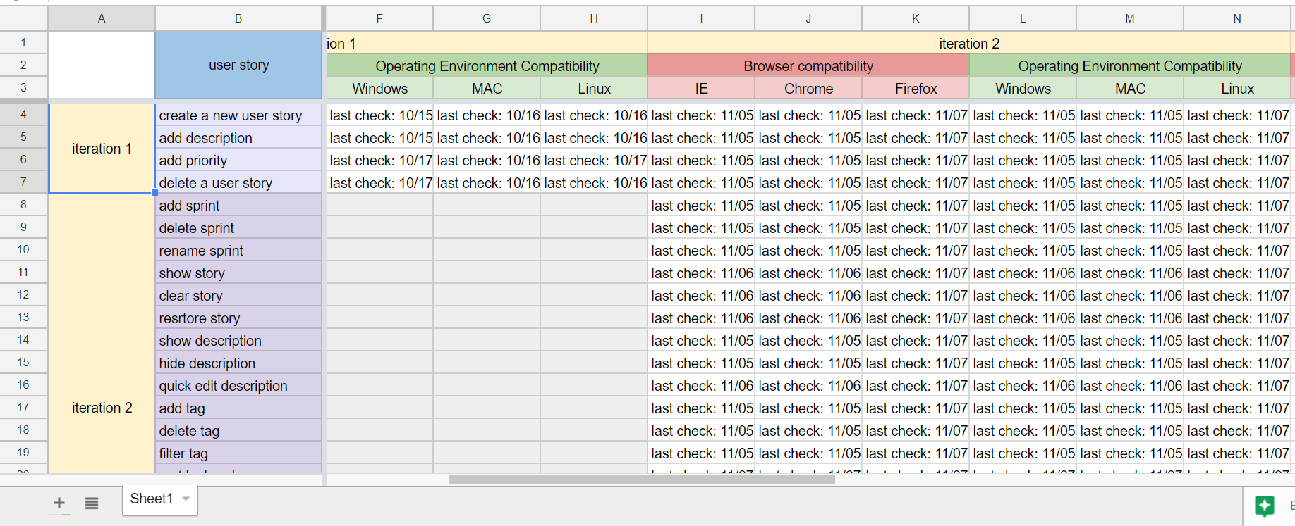
Compatibility Test

Slide 23
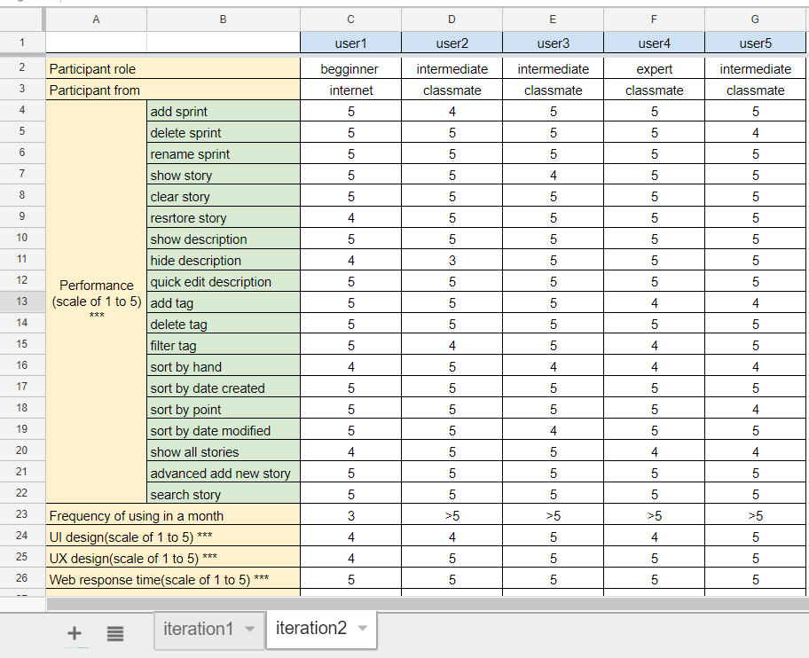
Usability Test
We follow our usability report based on 6 steps:
Goal
Recuit
Prepare for the study
Conduct
Analyze
Report

Slide 24
Testing Metrics
Product metrics
Defect management
Defect severity
Defect priority
Document
Test ID
Work log
Workflow
Report

Slide 25
Testing Metrics
Product metric
Schedule variance
Productivity for test case preparation
Productivity for test case execution
Expected test case result
Actual test case result

Slide 26
Testing Metrics
Process metrics
Number of user stories
Effort measured in person months/person's hour
Documents
STD
Test cases
Overall test report
……
Lines of code

Slide 27
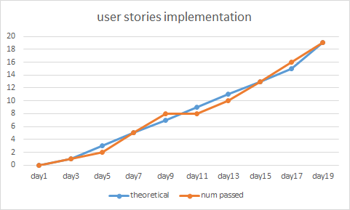
Sprint # | Line of Code (lines) | Total Effort (man hour) | Document Produced (pages) | Errors Found in Test (count) | Defects found in sprint (count) | User Story Implemented (count)
Sprint0 | 10 | 159 | 24 | 0 | 0 | 0
Sprint1 | 1458 | 166 | 72 | 10 | 3 | 3
Sprint2 | 3546 | 192 | 95 | 12 | 9 | 19
Test metrics table and graph

Slide 28
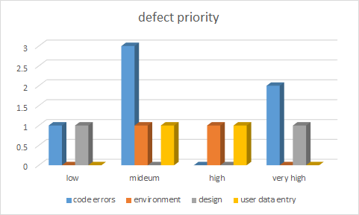
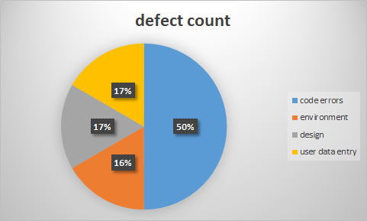
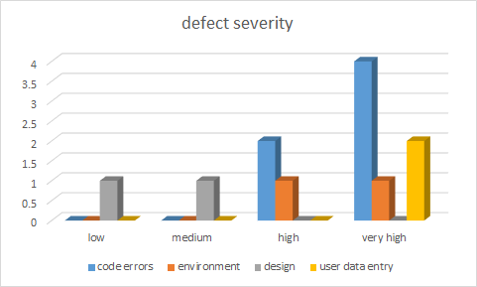

Slide 29
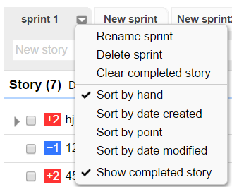
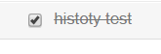

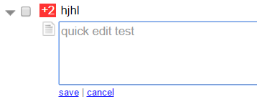
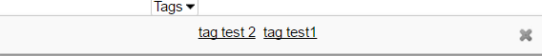
New Features
Sprint
Add, Delete, Rename
History
Show, Clear, Restore
Description
Show, Hide, Quick edit
Tag
Add, Delete, Filter

Slide 30
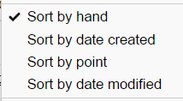
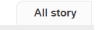

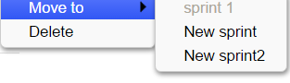
New Features
Sort:
Sort by hand(default)
Sort by date created
Sort by point
Sort by date modified
Others:
Show all stories
Advanced add new story
Search story
Other options for story

